Slide 1

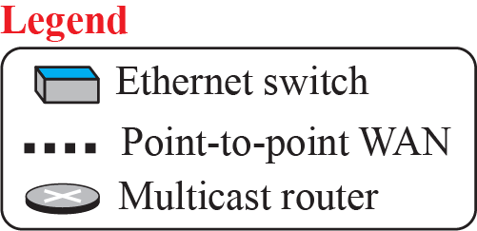
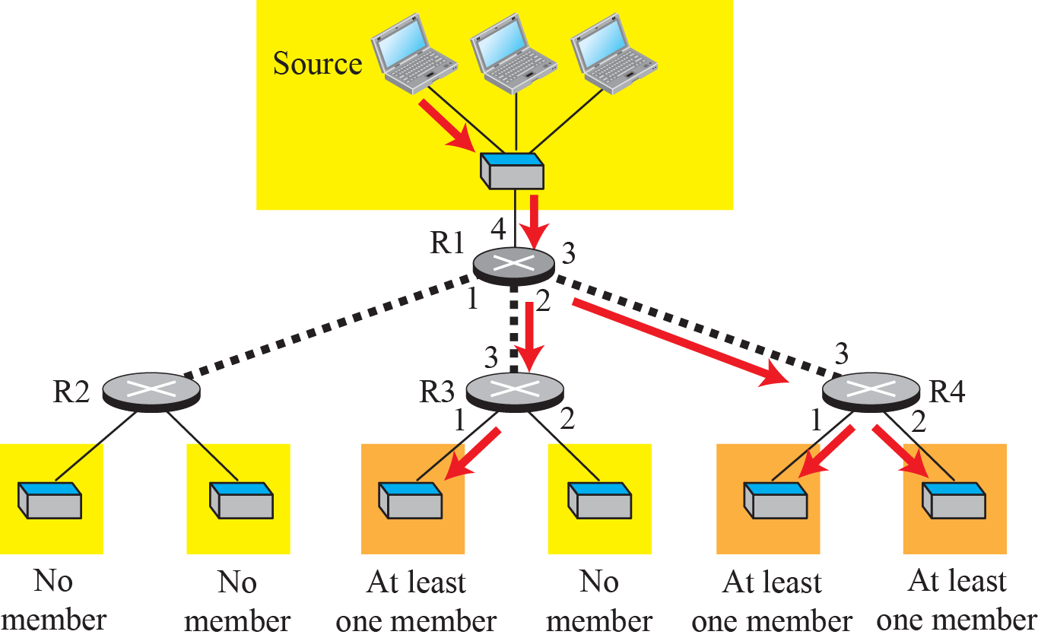
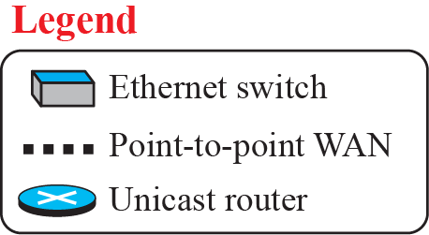
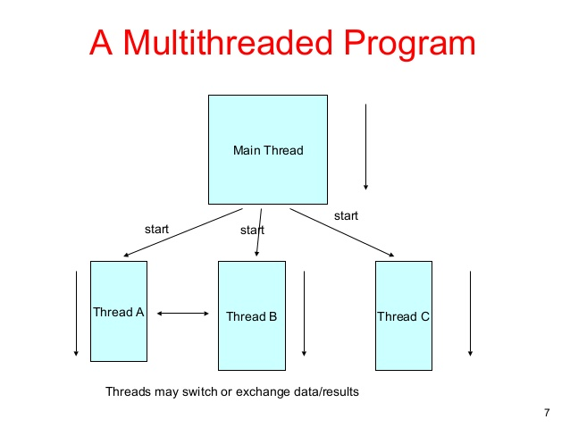
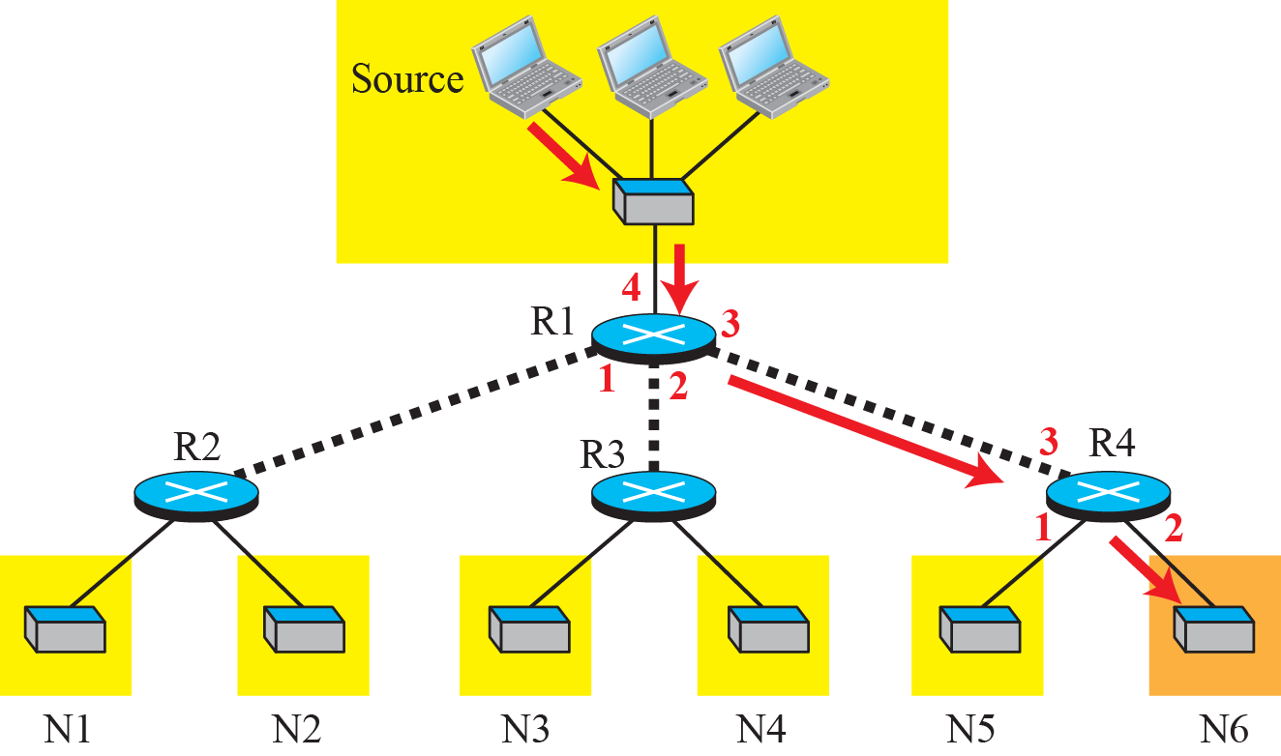
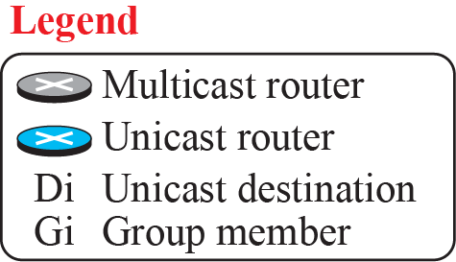
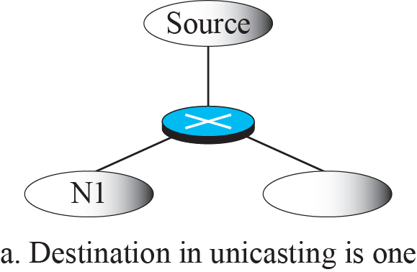
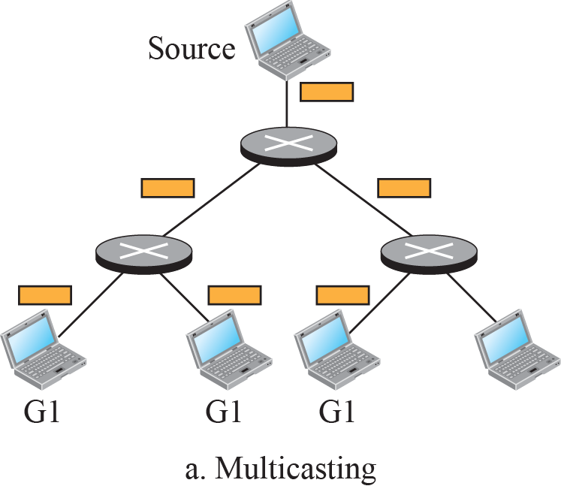
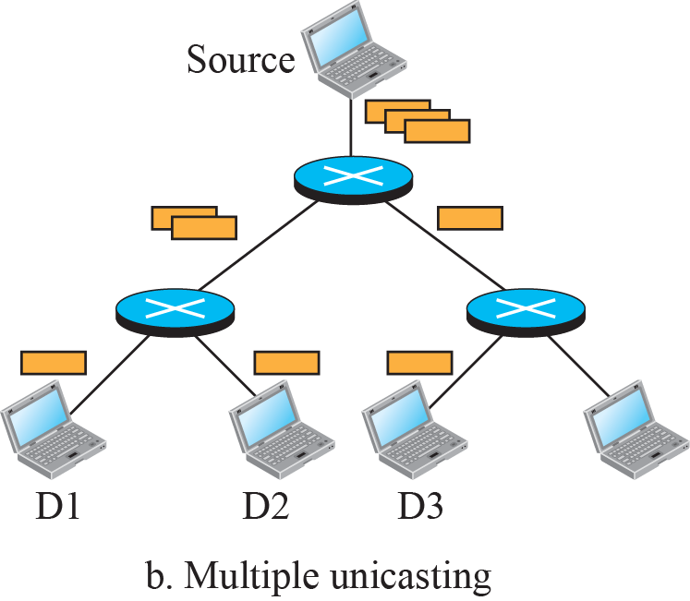
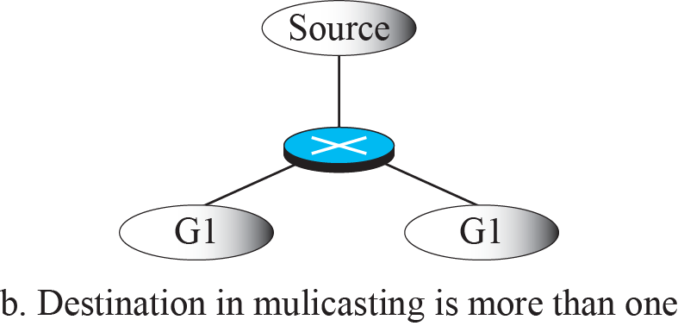
  Multi-Threading: An Application of Effective
  and Efficient Data Communication
Thu, Hein & Khafagi, Shereef A.
CPSC 353, Data Communications and Computer Networks
Schmid College of Science and Technology, Chapman University, Orange, CA
Introduction
Multi-threading is the ability of a program to manage multiple requests from a user and even manage multiple users at the same time. This technique is used in all aspects of data communication in today’s society as information is expected to be obtained instantly.
In order to understand the strengths, weaknesses, and applicability of this method we have created the game Salem Witch Trial where 9 users connect to a server and are able to communicate with the server independently as well as chat with one another.
The game description is as follows:
• The game will have 9 total players each having one of these roles:
- 2 Civilians (Innocents): Can vote to lynch people
each round.
- Doctor (Innocents): Heals one person (including himself) each night preventing them from dying.
- Sheriff (Innocents): Checks one person each night to investigate for suspicious activity and can find out if the target is a member of the Mafia, except for the Godfather and Vigilante.
- Lookout (Innocents): Watches one person each night to see who visits them.
- Vigilante (Innocents): Chooses someone each night to kill to save the town.
- Framer (Mafia): Chooses someone to frame at night. If the target is investigated, they will appear to be a member of the Mafia. If Mafioso dies, Framer will take their position.
- Mafioso (Mafia): Carries out Godfather’s orders. If Godfather dies, Mafioso will take their position.
- Godfather (Mafia): Kills someone each night if the Mafioso is dead. Else, the Mafioso will kill the target.
• The game ends when all Mafia members die or when the number of Mafia becomes equal to the number of Innocents.
• The game will repeat the rounds until the ending condition is met.
• Each round contains multiple stages:
- Day Talk
• Two minutes long.
• Every player alive can talk to each other on a chat server.
- Nomination
• Each player can nominate a person to lynch or choose to abstain.
- Night Talk
• One minute long.
• All Mafia members can discuss their plan.
- Night Action
• Players with roles will decide their actions.
- Explanation
• The server will take in all actions and calculate the outcome.
• The server will tell everyone who died and the cause of death.
Method
In order to implement the multi-thread needed for our program we first had to create a basic server and client, connect them via sockets, and create client listeners and handlers that would not only pass between the server and client but all other clients as well.
The idea behind multi-threading is to allow several processors to use a single set of code at different stages of execution. This way there is no repetitive code and the information remains consistent among all processes. This is made possible via the client listener and handler.
The client listener runs on the client end and simply displays any text received from the server to all designated clients. The client handler on the other hand runs on a separate thread but has a link to a common list of sockets to handle broadcast. Simply put, the handler communicates individually while the listener communicates with everyone.
Conclusion
The final result of the program has been achieved and the multi-thread within the game works perfectly. All information is sent and received quickly and reliably with all clients simultaneously.
Our game displays the effectiveness of multi-threading in data communication between multiple processes. While there are still areas in our code that can be improved upon, a great deal was learned and the experience is invaluable. Had we not used multi-threading there would be many more programs and processes running for each individual client. Furthermore those processes would only be able to communicate with one another one at a time and in turns.
Next we began inserting individual parts of the game in stages and updated the client handler accordingly. This was necessary since the client handler communicates specific messages to specific roles and passes any responses back to the server. The server uses that information in the Explanation stage later on. Along the way other classes were created such as Player.java, PlayerSync.java, Game.java, and Control.java in order to manage different features of the game more cleanly and efficiently. This new classes were incorporated into the server, client, listener, and handler accordingly.
With the multi-thread running smoothly and all appropriate classes needed were in place all that was left was the addition of detail, time-limits, and additional testing. There were some complications along the way as the game became more complex where some information was not being passed along accordingly. After some reviewing, debugging, and testing these bugs were identified and fixed effectively. Proper documentation of the code as it developed helped significantly in keeping things organized.

